Slide 1



Nutraceutics
Department of Drug and Food Control
presented by: H.Nobari Moghaddam
Sh. Tasharoei
PharmD, PhD candidate of Nutraceutics
Department of Drug and Food Control, Faculty of Pharmacy, Tehran University of Medical Sciences

Slide 2

We’ll talk about…
  History Of Department
  Curriculum
  About Nutraceutics
  Nutraceutics field in the worldwide
  Vision
  PhD thesis
  Research field
  Functional foods
  Job opportunity
  Our services

Slide 3





History Of Department
The Department of Food Chemistry and Medical Hydrology separated from the Department of Toxicology in 2002, and began to work as an independent department as the Department of Drug and Food Analysis in 2004, at the School of Pharmacy in Tehran University of Medical Sciences. From 2017 this department is known officially as Department of Drug and Food Control.

Slide 4
Curriculum

Slide 5
Curriculum

Slide 6
Curriculum

Slide 7
Two important fields
Analysis:
  Adulteration, analysis
Formulation:
  Nutraceuticals, functional foods

Slide 8
About Nutraceutics
The term Nutraceutics is a hybrid or contraction of nutrition and pharmaceutics.
Health Canada states that nutraceuticals are a product that is “prepared from foods, but sold in the form of pills or powders (potions), or in other medicinal forms not usually associated with foods. A nutraceutical is demonstrated to have a physiological benefit or provide protection against chronic disease.”
Health Canada defines functional foods as “similar in appearance to a conventional food, consumed as part of the usual diet, with demonstrated physiological benefits, and/or to reduce the risk of chronic disease beyond basic nutritional functions.”
Notes:
New York, US; an educational foundation established in the US to encourage discoveries in medicine

Slide 9
Nutraceutics field in worldwide
Nutraceuticals PhD Positions in Pharmacy Schools (Italy/ Napoli)
Nutraceuticals PhD Positions in Pharmacy Schools (Czechia/ Prague)
Nutraceuticals PhD Positions in Pharmacy Schools (Italy/ Camerino)
Nutraceuticals research groups in pharmacy departments (Italy/ Bologna)
Nutraceuticals research groups in pharmacy departments
(Australia/ Callaghan / School of Biomedical Sciences & Pharmacy)
Nutraceuticals research groups in pharmacy departments (England/ London)

Slide 10
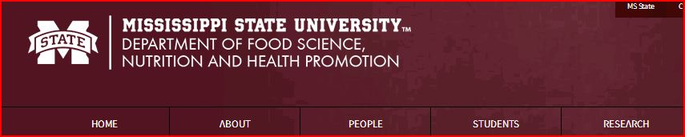
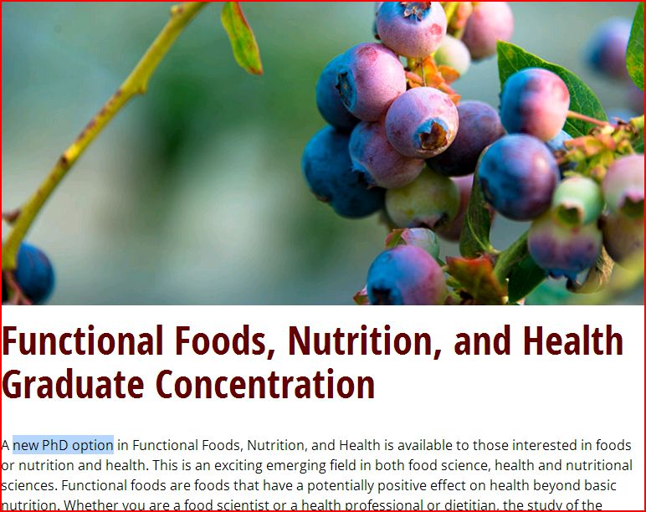
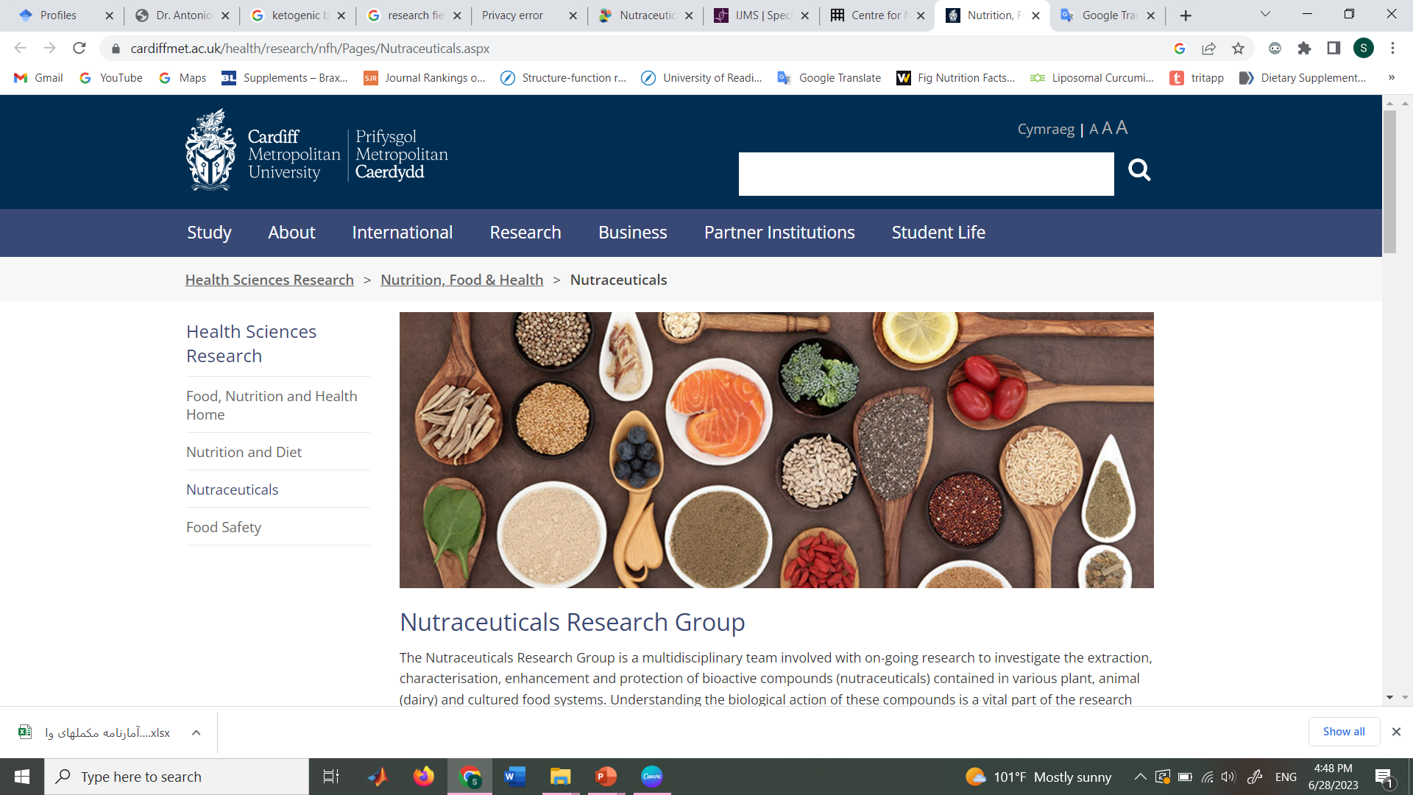

Slide 11

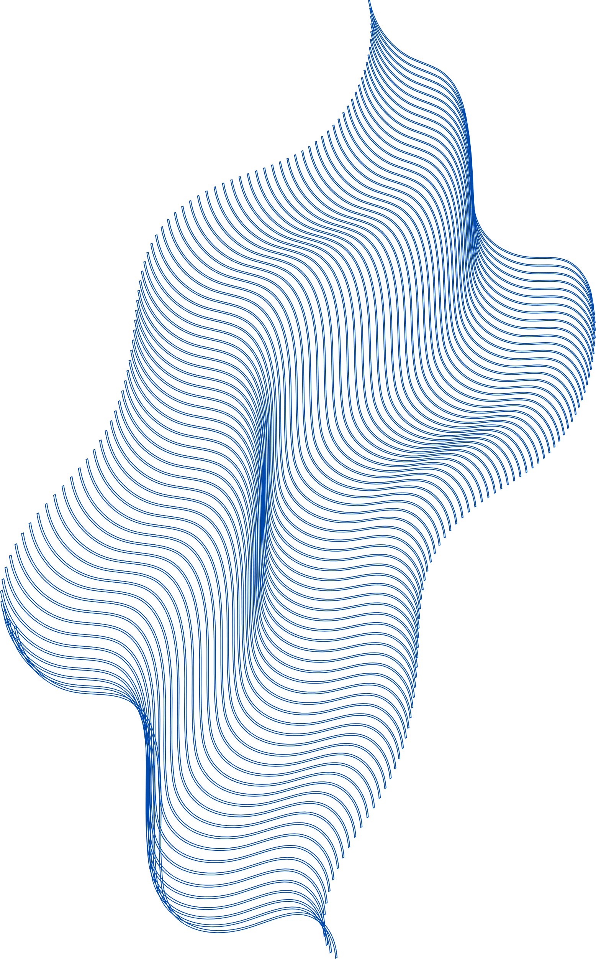
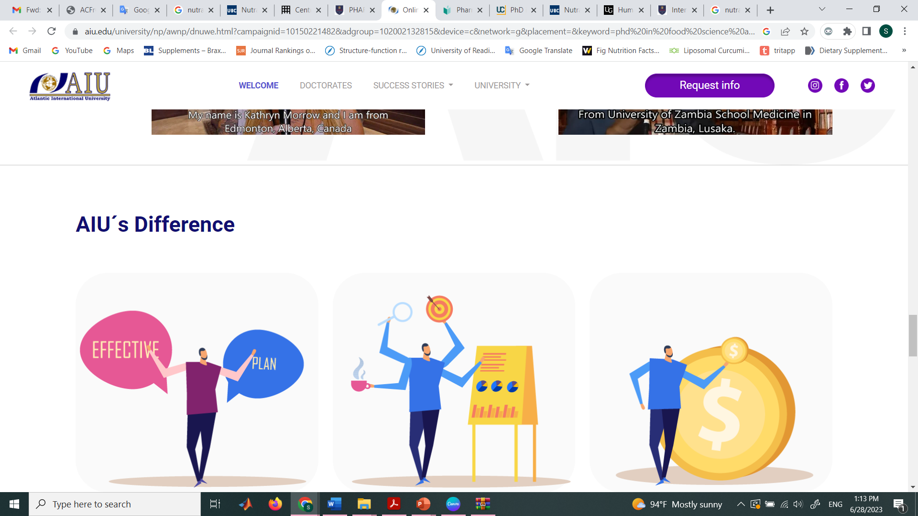
Vision
To have the research area of 'nutraceuticals" fully recognized by the University of Tehran.
Designing and Formulation of Functional foods and novel nutritional supplements
Improving the quality of food products, beverages, supplements, baby and baby food, food, medicines and super-beneficial foods.
Improvement and setting up new analysis methods

Slide 12
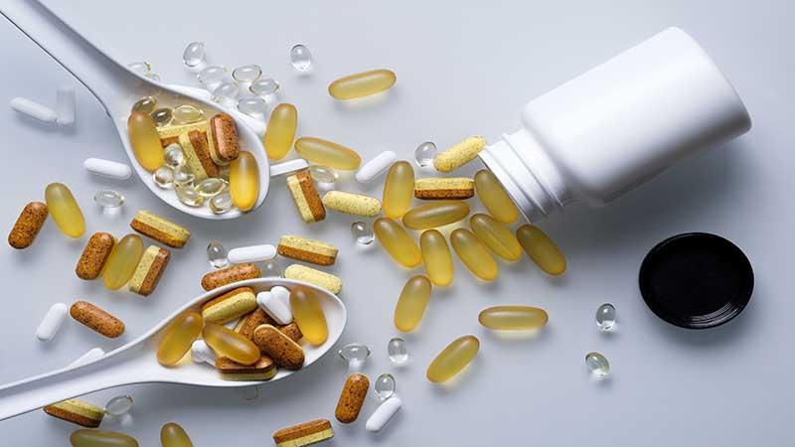
Nutraceuticals:
New Opportunities for Pharmacists
STAY INSPIRED. NEVER STOP CREATING.
Collaborative, contract research and consultancy projects (product development, analysis and validation services, and clinical testing via human intervention studies)
Knowledge dissemination via publications, conferences and public engagements

Slide 13
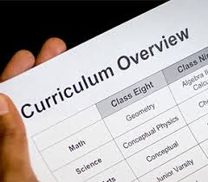
Scientific Field Of The Group
Advanced statistical methods and chemometrics
Organizations, structures, rules and regulations of food products, supplements, and pharmaceuticals
Food drug interaction and nutriovigilance
The principles of storage and stability of food products, supplements and food products
Processing of edible products, supplements and Nutraceuticals(familiarity with the production method and Formulations)
Microbial control of food products, supplements and Functional Foods

Slide 14
Functional foods

Slide 15
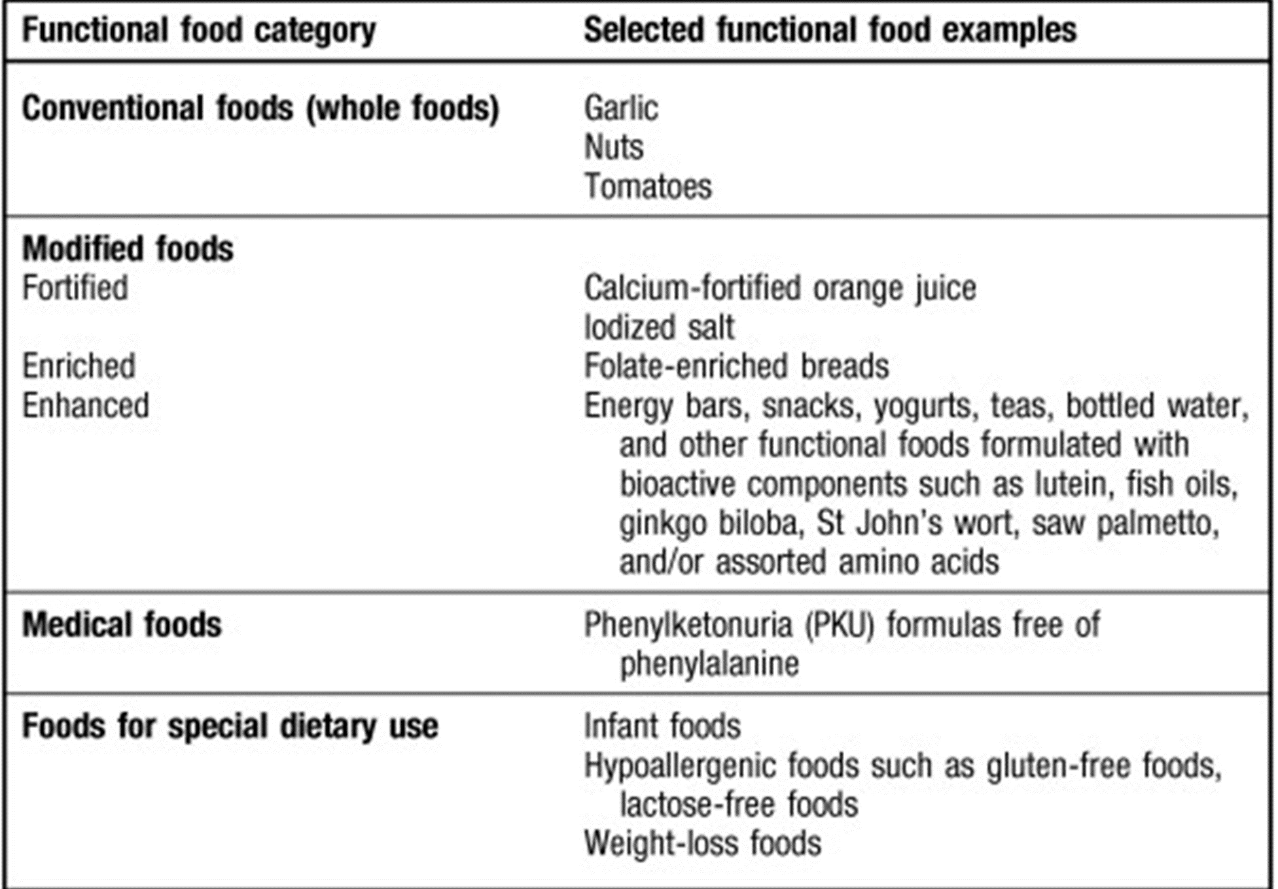

Slide 16
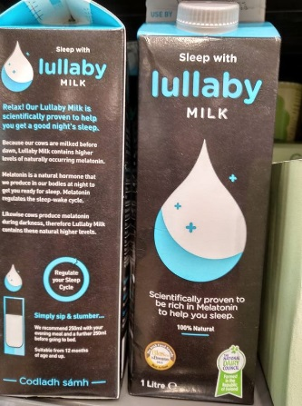
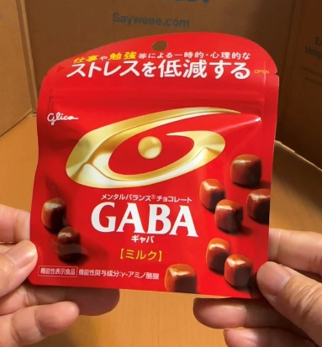
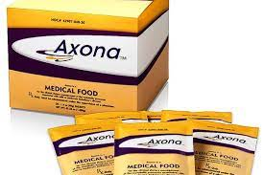
Products
Axona is a first-in-class medical food for the clinical dietary management of the metabolic processes associated with mild-to-moderate Alzheimer’s.
Lullaby Milk contains higher levels of melatonin.
GABA chocolate is only on sale in Japan.

Slide 17
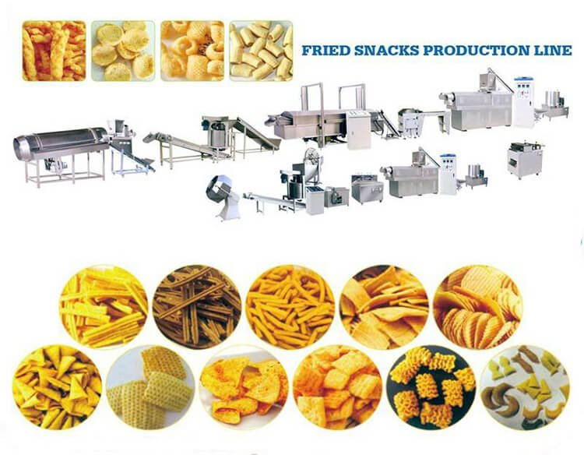
Job opportunity
Food industry

Slide 18


OUR SERVICE
  Service 01
  Service 02
Cooperation with the industry in the field of standardization of supplements, herbal, traditional, food and cosmetic-health products.
Providing specialized services to industries regarding the analysis and design of nutraceutical and food drug formulations.
  Service 03
  Service 04
Monitoring nutritional status in diets and counseling in the field of drug and food interactions.
Quality control of food and pharmaceuticals

Slide 19

PhD thesis
Development of nondestructive methods in assessment of authenticity of sport whey protein Supplements.
Design, preparation and control of food SPREAD and quantitative and qualitative analysis of its characteristics.
Berberis vulgaris L. Extraction containing Berberine and Design, preparation& Physicochemical characterization of oral film of Extract by using design of experiment.
Preparing and optimizing the classic 4:1 ketogenic formulation and investigating its ketogenic status in patients with traumatic brain in injury

Slide 20
Research Field Of The Group
Optimization of black seed oil extraction method using statistical multivariate methods and quantitative and qualitative analysis of the extracted oil.
Investigating the stability and effectiveness of food, drug and food formulations based on new statistical methods and chemometrics.
Functional food, analysis of bioactive compounds by analytical techniques (nanoLC, LC or EC) with mass spectrometry (IT, TOF and QTOF).
Characterization of polyphenols compounds in food (olive oil, beer, honey and derivates bees, vegetables and fruit) and nutraceutical preparations

Slide 21



