Slide 1


25th meeting of world congress on clinical nutrition

Slide 2
Dr. Ardalan Shariat
Department of Digital Health, School of Medicine, Tehran University of Medical Sciences

Slide 3
Efficiency of Telehealth, a combination of physical and physiological approaches, for the patients post stroke: A narrative review

Slide 4

Introduction
What is telehealth?
A broad term encompassing the purveyance
of health-related content through the use of telecommunication technologies.

Slide 5
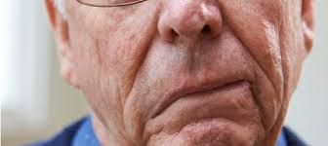
Introduction
Stroke is one of the leading causes of disability in the world with enormous economic burden is stroke.

Slide 6
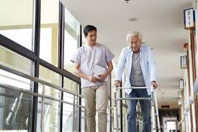
Introduction
Patients post-stroke are not able to do their daily activities independently. They need to do regular physical exercises and also it is essential to follow regular patterns of diet and sleeping.

Slide 7
Introduction
It should be noted that with attention to the complicated situation of financial issues in the world, it is challenging for families to pay for daily visits of occupational therapists or physical therapists.

Slide 8
Introduction
So, using from online platforms with lower costs (in time and money) could be useful and cost-beneficial, not only for the patients and their families but also for the therapists.

Slide 9

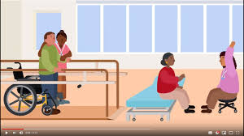
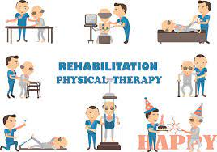

Slide 10
Aim
With care to this point, we have tried to organize a narrative review with a focus on Telehealth and Tele exercise (a combination of physical and physiological approaches) for the patients post-stroke.

Slide 11
Methods
Among available databases, PubMed, Scopus and Web of sciences were searched for the English papers published from 2012 till Sep 2022.
The keywords for this search were Telehealth, Telemedicine, tele exercise, stroke and telerehabilitataion.

Slide 12
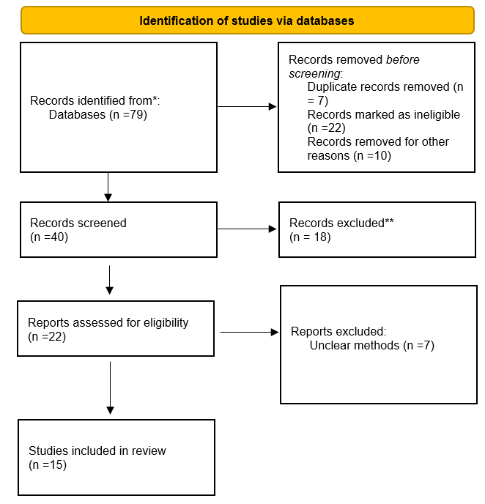

Slide 13
Results
Finally among 79 papers inserted in Mendeley, 15 papers were analyzed. Ineligible papers and those papers with unclear methods were excluded.
The 15 selected papers had focus on physical and physiological approaches such as physical ability of patients post stroke or nutritional consultation for them.
Most of them had focused on tele rehabilitation as a cost effective way for rehabilitation of patients post stroke.

Slide 14
Results
Community based rehabilitation was another practical method.
“it is currently unclear how effective this model of delivery is relative to rehabilitation delivered face‐to‐face or when added to usual care”, emphasized by an expert in 2020.

Slide 15
Conclusion
As a home message, and based on the findings by the author, the practical role of telehealth for patients was clear and useful, but there is a need for further research to compare the benefits and deficits of using online platforms in comparison with face-to-face therapies.

Slide 16
References
Dodakian, L., McKenzie, A. L., Le, V., See, J., Pearson-Fuhrhop, K., Burke Quinlan, E., ... & Cramer, S. C. (2017). A home-based telerehabilitation program for patients with stroke. Neurorehabilitation and neural repair, 31(10-11), 923-933.
Laver, K. E., Adey‐Wakeling, Z., Crotty, M., Lannin, N. A., George, S., & Sherrington, C. (2020). Telerehabilitation services for stroke. Cochrane Database of Systematic Reviews, (1).
Knepley, K. D., Mao, J. Z., Wieczorek, P., Okoye, F. O., Jain, A. P., & Harel, N. Y. (2021). Impact of telerehabilitation for stroke-related deficits. Telemedicine and e-Health, 27(3), 239-246.
Appleby, E., Gill, S. T., Hayes, L. K., Walker, T. L., Walsh, M., & Kumar, S. (2019). Effectiveness of telerehabilitation in the management of adults with stroke: A systematic review. PloS one, 14(11), e0225150.
Chang, M. C., & Boudier-Revéret, M. (2020). Usefulness of telerehabilitation for stroke patients during the COVID-19 pandemic. American journal of physical medicine & rehabilitation.
Linder, S. M., Rosenfeldt, A. B., Bay, R. C., Sahu, K., Wolf, S. L., & Alberts, J. L. (2015). Improving quality of life and depression after stroke through telerehabilitation. The American Journal of Occupational Therapy, 69(2), 6902290020p1-6902290020p10.
Peregrin, T. (2019). Telehealth is transforming health care: what you need to know to practice telenutrition. Journal of the Academy of Nutrition and Dietetics, 119(11), 1916-1920.
Farid, D. (2020). COVID-19 and telenutrition: remote consultation in clinical nutrition practice. Current Developments in Nutrition, 4(12), nzaa124.

Slide 17
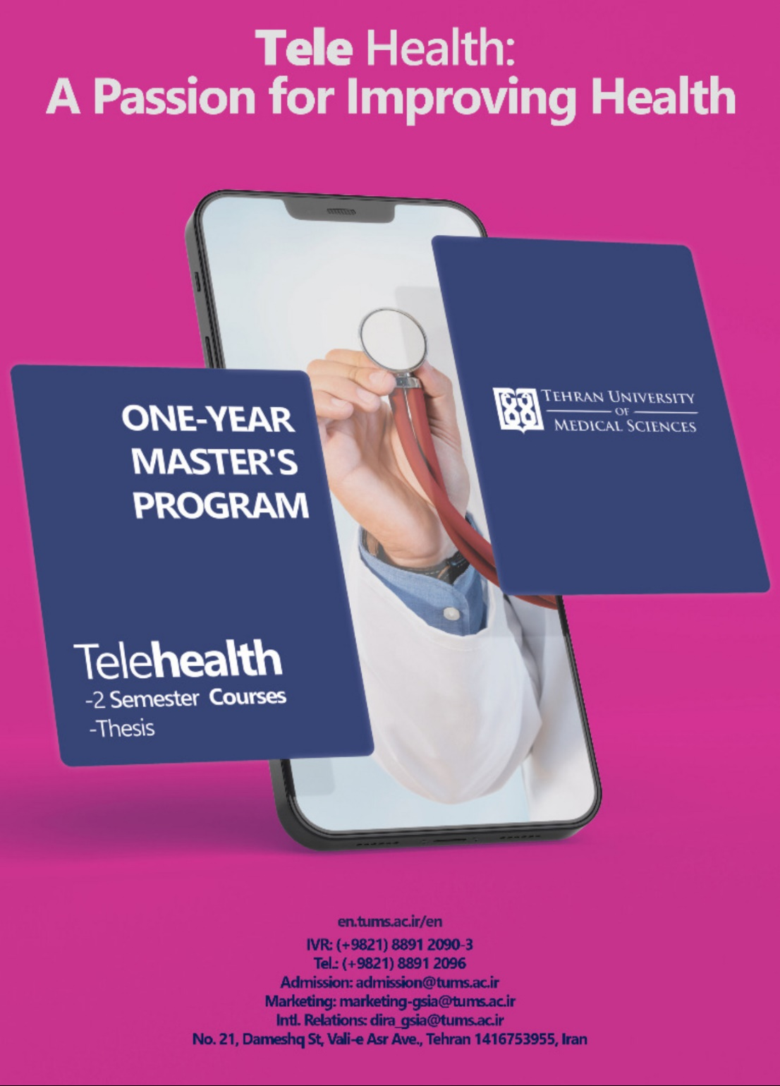

Slide 18


