Slide 1
International Collaborations in Nursing Research
Reza Negarandeh
Professor at School of Nursing & Midwifery, Tehran University of Medical Sciences, Tehran, Iran
Head of Nursing & Midwifery care research center
Editor-in-chief, Nursing Practice Today
rnegarandeh@tums.ac.ir

Slide 2
International Collaborations in Nursing Research
Reza Negarandeh
Editor-in-chief, Nursing Practice Today
rnegarandeh@tums.ac.ir

Slide 3
"Nursing Practice Today" (NPT) is a peer-reviewed, open access international scientific journal that publishes original scholarly work which is essential for nurses and midwives who are serious about developing their own professions, as well as providing the best outcomes for the clients in their care.
Reports of original research and scholarly papers about all aspects of nursing and midwifery practices that have a sound scientific, theoretical or philosophical base are published.

Slide 4
Journal History & Statistics
First year of publication | 2014
Number of volumes | 9
Number of issues | 34
Published articles | 259

Slide 5
Indexing & Abstracting
Web of Science: Emerging Sources Citation Index
CINAHL Complete
ProQuest
Scopus
Dimensions
Directory of Open Access Journals (DOAJ)
Directory of Research Journal Indexing (DRJI)
Index Medicus for Eastern Mediterranean Region (IMEMR)
EBSCO
Google Scholar
Islamic World Science Citation Center (ISC)
Magiran
NLM Catalog
Publons
Scientific Information Database (SID)
Ulrichsweb

Slide 6
Editors

Slide 7
Geographical distribution of editorial board members
1 member
from Norway
1 member
from Sweden
1 member
from USA
1 member
from Iraq
5 members
from Iran
1 member
from Thailand
1 member
from Greece
1 member
from Colombia
1 member
from Australia

Slide 8
CiteScore & CiteScore Tracker

Slide 9
Definition of Nursing Research
Nursing research develops knowledge about health and the promotion of health over the full lifespan, care of persons with health problems and disabilities, and nursing actions to enhance the ability of individuals to respond effectively to actual or potential health problems.
As with other practice professions, nursing requires a knowledge foundation that is based on theory and derived from systematic research.
Hence, Improving patient care is the prominent focus of nursing research.

Slide 10
NURSING RESEARCH DEVELOPMENT
In 1859, Nightingale used the battlefield hospitals of the Crimean War as her research laboratory, using an epidemiological process to describe the morbidity and mortality of sick and injured soldiers. Her pioneering epidemiological research and statistical methodology (documenting the relationship between the environment and health status of soldiers) was the hallmark of scientific investigation in nursing.
It was not until the 1980s that nursing devoted a sizeable portion of its research effort to recognize the interplay between behavior and rehabilitation or recovery from illness.
During the 1990s nurses increasingly used qualitative research methods, such as phenomenology and ethnography, to explain complex human phenomena.

Slide 11
Research utilization
The conduct of research is not the end, but rather a means through which practice is improved by utilizing research findings.
Research utilization is the process of conveying and applying research-based knowledge to impact or change existing practices in the health care system.
The primary components of research utilization involve summarizing knowledge generated through research; imparting the research knowledge to nurses, other health professionals, policymakers, and consumers of health care; and accomplishing desired outcomes for patients, their families, and health care providers and agencies.

Slide 12
Evidence-based practice
An important trend is the use of research findings to serve as the basis for treatment decision making called evidence-based practice.
Using this process, a question involving treatment is developed, and determination of the adequacy of current research is made.

Slide 13
Directions for Research
Nurses found that if they want to have a evidence-based practice, they should be follow these research priorities:
1. Promoting health, well-being, and competency for self-care among all age groups;
2. Preventing health problems throughout the life span that have the potential to reduce productivity and satisfaction;
3. Decreasing the negative impact of health problems on coping abilities, productivity, and life satisfaction of individuals and families;
4. Ensuring that the care needs of particularly vulnerable groups are met through appropriate strategies;
5. Designing and developing health care systems that are cost-effective in meeting the nursing needs of the population.
Notes:
Research conducted by nurses includes various types of studies in order to derive clinical interventions to assist those who require nursing care.
Hence, nursing research cuts across traditional research lines, and draws its methods from several fields.

Slide 14
Nursing research advancement is due to many factors:
an increase in the number of nurses with advanced academic preparation,
the establishment of vehicles for dissemination of nursing research,
funding and support for nursing research,
the upgrading of research skills in faculty and students.

Slide 15
An increase in the number of nurses with advanced academic preparation
Early nursing education took place in hospital training programs (nursing diploma). In Iran since 1915.
In 1915, nursing’s educational accrediting body, the National League for Nursing (NLN) called for university-level education. In Iran this is occurred after the mid of 1900.
Baccalaureate programs in nursing emerged in 1923 at Yale University and Western Reserve University, but the majority of nursing education took place in hospital-based diploma programs. This degree in Iran was established in 1963.
For many years, the Master’s degree was considered the terminal degree in nursing. In Iran until 1994.
The number of doctoral programs in nursing has increased from zero in the 1950s to over 65 institutions, three-fourths of which are academic doctorates (PhD) that prepare graduates for a lifetime of scholarship and research.
More recently, nurses in academic settings have been encouraged to obtain postdoctoral research training
Academically educated nurses can adopt broader responsibilities in the research of health systems (WHO, 2021).

Slide 16
The establishment of vehicles for dissemination of nursing research,
The first journal of Nursing Research established in 1952.
During the 1950s, regional research conferences were instituted for the first time, and federal support of nursing research began.
Several new nursing research journals, including Applied Nursing Research (ANR), were instituted in the late 1980s.
Today, there is 179 journals in the subject of general nursing in SCOPUS. The number of journals which considered nursing articles is about 400 journals.

Slide 17
Funding and support for nursing research
Next honor speaker will discuses about the funding.
Nursing databases have a particularly significant role in nursing research.
Such databases can be used to search topics of interest and to identify areas that are understudied.
The Cumulative Index to Nursing and Allied Health Literature (CINAHL) database provides access to thousands of full-text journals relating to nursing; however, several other databases also cover nursing science and research journals, i.e., Cochrane Library, ProQuest, Emerald, PubMed, Springer Link, Sage, and Web of Science, and the availability of the full texts is dependent on the licenses (individually or from your institutions).
Notes:
librarians and the research material available in libraries are the most important infrastructural components in nursing research.

Slide 18
The upgrading of research skills in faculty and students
Besides pedagogical and clinical nursing skills, nurse educators and their students must strengthen their research skills.
Also up-to-date ICT skills, tools and software is needed.
According to WHO ( 2021) Networking and international mobility programs have been identified to increase the research capacity.
Notes:
Availability of nursing research textbooks for teaching in research courses.
Availability of workshops for how to conduct research including basic to advance levels.
Usually graduate from MSc and PhD curriculums have ability to do research in their career.

Slide 19
International Collaborations in Nursing Research
Definition:
International research collaboration in nursing is ‘an effective method of building nursing science, improving health care globally, preparing future researchers, and improving nursing’s visibility and credibility.

Slide 20
Background
NURSING AND RESEARCH are undergoing two global transformations.
The first transformation concerns nurses taking control of their practice by undertaking nursing research.
The second transformation in nursing and research is that cross-national studies are becoming more common.
As early as 1988, Futrell argued for the need for cross-national research in gerontological nursing.
In 2005, Fitzpatrick wrote that the next stage needed in worldwide work is the ‘extension of collaboration across cultures and countries toward international collaborative research on a wide-scale level.
Notes:
Cross-cultural or cross-national researches are widely used in different disciplines, such as philosophy, anthropology, sociology, law, education, politics, and health.

Slide 21
As one of the main providers of direct healthcare services, nursing is in a unique position to lead the way in international, practice-based research.
International nursing partnerships have become an increasingly popular method of exchanging nursing knowledge and providing nursing assistance across the globe.

Slide 22
International Collaborations in Nursing Research benefits:
Globalization and international research collaboration and partnership with other educational institutions strengthens the evidence base for global health policy.
Global healthcare issues, such as emerging and spreading diseases, workforce shortages, tele-health and tele-education are continuing to drive and fuel the need for international research.
Nursing, like many professions, is required to find broader, collaborative solutions to the increasing complexity of global issues that face health care and the education of students.
Furthermore, such efforts attract specialists in certain fields from external institutions (European Commission, 2021).

Slide 23
International Collaborations in Nursing Research Barriers:
Evidence suggests that more nurses are leading research. However, coordinating research projects is complex and involves management of people, processes, budget and material resources.
These issues become even more important in international research and pose more serious obstacles to the international cooperation of researchers.
The capacity to generate new knowledge and implement that knowledge into global practice is impeded by culture and language differences.

Slide 24
Barriers: Language
Language is the most highly developed of symbolic processes, and a tool for communication with one’s self and others.
Learning research processes is like learning a new language with very precise meanings.
Language translation of not only the words but also their meanings is vital to the relevant application of the study results.
Notes:
Transaction costs and communication barriers to international collaboration
may suppress novelty.

Slide 25
Barriers: Culture
Cultural and regional distinctions
Not knowing the culture and moral priorities of other countries
Culturally sensitive instruments
Instrument translation and cultural adaption
Notes:
Transaction costs and communication barriers to international collaboration
may suppress novelty.

Slide 26
Other barriers
Different contexts
Differences in healthcare systems
Differences in nursing care delivery models
limited resources & training
Lack of financial support for international nursing research
Nursing faculty shortage
Lack of collaborative research
Lack of resources or expertise to publish among some nurse scientists
Lack of training, mentors, funding, and opportunities

Slide 27
International Collaborations in Nursing Research: concerns
Using data from Web of Science and Scopus, Wagner et al. failed to show that international collaboration produces more novel articles. Actually, they stated that international collaboration appears to produce less novel and more conventional knowledge combinations.
Transaction costs and communication barriers to international collaboration may suppress novelty.
Notes:
International research collaboration – advantages and requirements
P€aivi Astedt-Kurki PhD, RN
Professor, Editor-in-chief/SJCS
Marja Kaunonen PhD, RN
Professor, Editor/SJCS
Tampere University, Tampere, Finland

Slide 28
How to improve the quality of International Collaborations in Nursing Research
The collaboration Should be true and long-lasting.
There should be a new and modern idea between the partners, looking towards the future.
It is essential to understand each other and different ways of thinking and how to put them to work together.
The clear definition of the division of the workload and true commitment for the application is needed.
There are also many practical issues to be solved, for example how to communicate during the work.
New ways, such as Skype or sharing documents, are helpful, but they cannot always substitute the face-to-face meetings and dialogue between the partners.
The work attitudes differ from country to country, and for example how important it is to keep the promised deadlines varies.

Slide 29
Building International Research Capacity
Although nursing research in general, and international nursing research in particular, has expanded rapidly in the last several decades, the establishment of an international nursing research agenda has lagged behind.
Working collaboratively through global networks of research, we can strengthen the impact of our scientific discoveries as we strive to enact research that will improve the quality of life for the global community.
Organizations such as the International Council of Nurses (ICN) and Sigma Theta Tau International, have created ‘electronic neighborhoods’ that serve as global networks to exchange information related to nursing research.
https://www.icn.ch/
https://www.sigmanursing.org/
Notes:
Developing anInternationalCommunityofResearch
Desarrollo deunacomunidadinternacionaldeinvestigacio´n$ PatriciaA.Grady,PhD

Slide 30
Research Priorities
To promote healthier communities and evidence-based care, a world-wide attention was give emphasis to determining global health priorities.
The nursing research priorities for many countries show many similar interests and opportunities for collaboration. It mandates that profession should expand research beyond borders through collaborative international partnership.
International networks bring together the global nursing community to identify areas in need of research development, disseminate new scientific findings, and foster international relationships among investigators.

Slide 31
Research Priorities
A source of international nursing research priorities is the International Council of Nurses’ (ICN) document entitled, ‘Nursing research: a tool for action’. The ICN priorities are listed in two broad areas: health and illness; and delivery of care services.
Areas such as health promotion, illness prevention, Symptom control, chronic illness lifestyles and quality of life are subsumed under the health and illness category.
Furthermore, research priorities are indicated for all aspects of the nursing process, including assessment, nursing care interventions and measurement of outcomes.

Slide 32
Research Priorities
Sigma Theta Tau International has developed a ‘Resource paper on global health and nursing research priorities’. This resource paper lists 10 global nursing research priorities, including:
health promotion and disease prevention;
advocacy and promotion of health of vulnerable and marginalized communities;
quality of health and patient safety;
development of evidence-based practice and transnational research;
promotion of health and well-being of the older person;
patient-centered care and care coordination;
palliative care and end-of-life care;
genetic testing and therapeutics: implications for care;
capacity development of nurse researchers and nursing education;
nurses’ working environments.

Slide 33
WHO Collaborating Centres for Nursing
The Global Network of WHO Collaborating Centers for Nursing & Midwifery works with its members, partners, and the World Health Organization towards a shared vision and mission.

Slide 34
Who is a part of the Global Network?
The Global Network connects several important leaders in public health , nursing, and midwifery at the local, regional, and global levels. Together, these institutions, organizations, and individuals work together to achieve the World Health Organization’s vision of Health for All.

Slide 35
VISION
MISSION
A Global Network of Nursing and Midwifery Leaders
The mission of the Global Network of WHO Collaborating Centers is to promote the Health For All populations through the collaboration, communication, and cohesion of the nursing and midwifery global community and its partners.

Slide 36
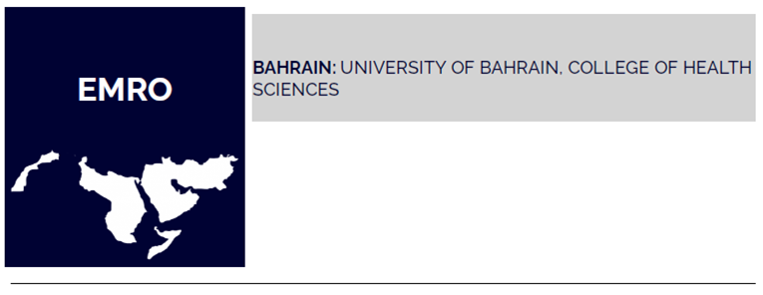
Collaborating Centers

Slide 37
Nursing Research Foundation, NRF
Tasks of the NRF: • To synthesize the best available evidence: e.g. national evidence-based clinical guidelines for nursing (Hotus-guidelines), Evidence Tips, systematic reviews, scoping reviews, rapid reviews • To disseminate the evidence: e.g. publications, statements, lectures in the field of evidence-based health care • To support the implementation of the evidence: operational models for supporting implementation, such as Consistent nursing practices – a model for developing evidence-based practices (OMEBP) and The Action Model for Expertise (FinAME). In addition, NRF participates in collaborative projects promoting the evidence-based healthcare (EBHC).
Two international collaboration centers The NRF is hosting two collaborating Centers, which main mission is improving EBP on both national and international level: • WHO Collaborating Centers for Nursing (since 1977) • The Finnish Center for Evidence-Based Health Care: A JBI Center of Excellence (since 2010)
https://www.hotus.fi/nursing-research-foundation-nrf/?lang=en

Slide 38
Global Network of Public Health Nursing (GNPHN)
GNPHN aims to support public health nurses in developing their practice where ever they work in the world.
Sharing of knowledge and public health nursing practice across the world has been the driving force of the five International Public Health Nursing conferences which took place in 2009, 2011, 2013,2016 and 2019. At these conferences, the delegates identified the need for a forum to support the ongoing conversations and discussions between the conferences.

Slide 39
Notes:
https://www.icchnr.org/about-icchnr/

Slide 40
Notes:
https://www.nursesinaidscare.org/i4a/pages/index.cfm?pageid=4551

Slide 41
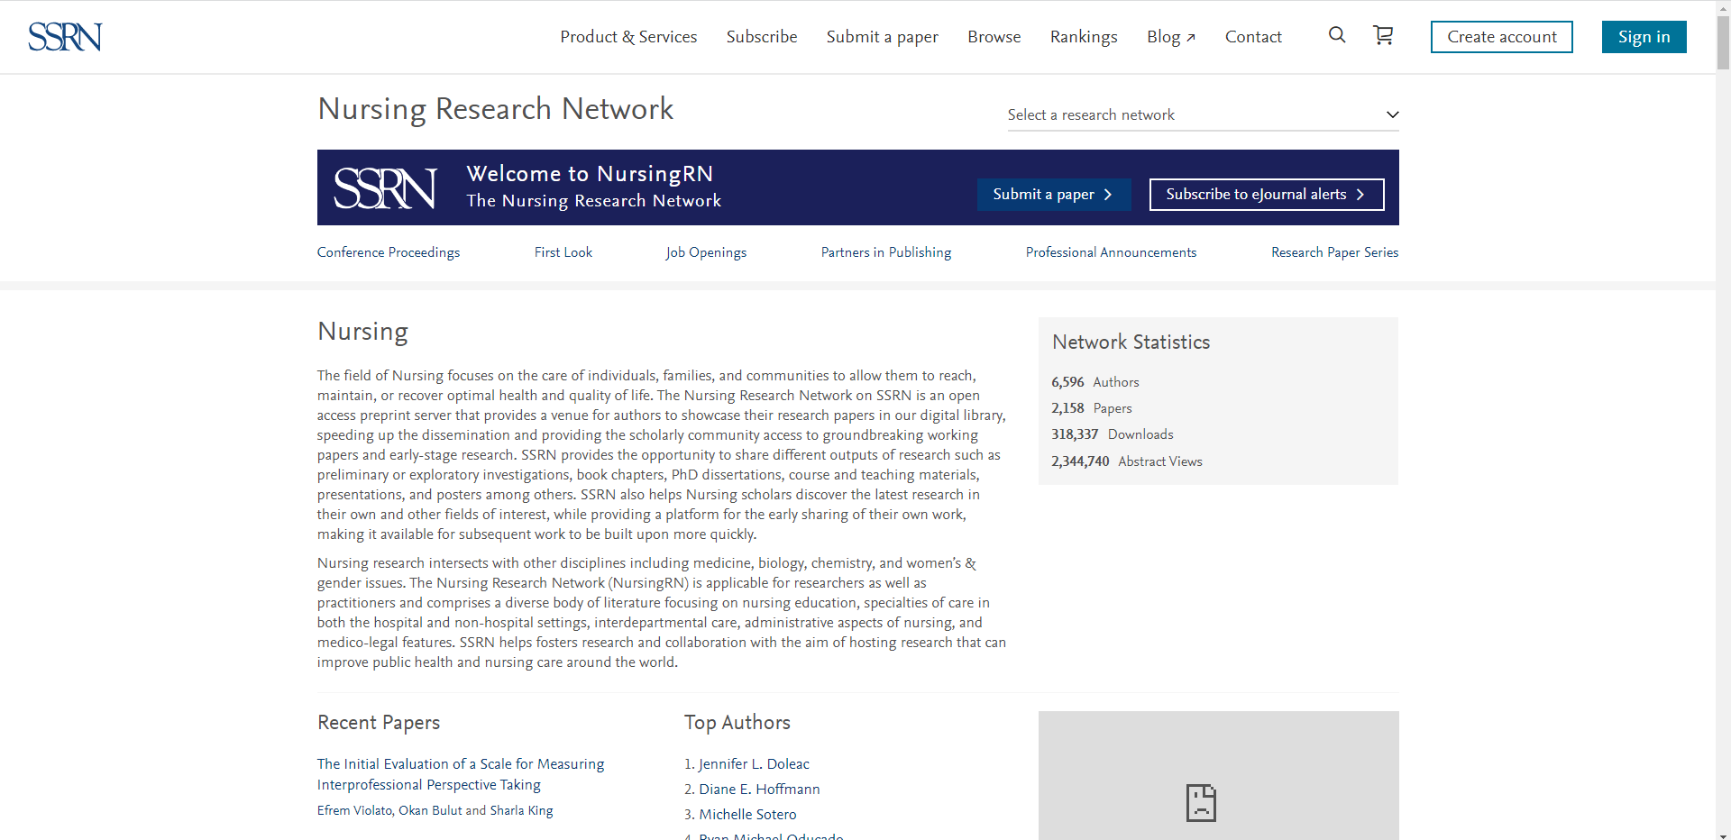
Notes:
https://www.ssrn.com/index.cfm/en/nursingrn/

Slide 42
Notes:
https://nursingnet-en.tbzmed.ac.ir/

Slide 43
Notes:
https://indenglobal.org/about

Slide 44
Notes:
https://globalresearchnurses.tghn.org/about/

Slide 45
Ethical Considerations in International Nursing Research
The two factors that determine the level of ethical concern are the degree of cultural difference between the involved countries and the potential for exploitation.
Studies with principle investigators from a more developed country who are recruiting participants from a less well-developed country are of greater concern than collaboration between researchers of similarly developed countries collecting data for purposes of comparison, because of the greater potential for exploitation.
Method and data-gathering techniques of particular concern to nurses, such as interviewing, psychosocial intervention, participant observation, and other anthropological techniques, may be liable to different types of problems to quantitative health care research.

Slide 46
Ethical Considerations in International Nursing Research
In the context of international HIV/AIDS research, UNAIDS identified factors that create conditions that make countries or communities potentially vulnerable to exploitation. These include:
the level of the proposed community’s economic capacity;
limited experience with, or understanding of, scientific research in the country as a whole; limited local infrastructure, personnel and technical capacity for providing health care and treatment options;
limited experience and capacity for conducting ethical and scientific review;
an uncertain ability of individuals in the community to provide informed consent, for instance, as a result of class, gender and other social patterns.

Slide 47
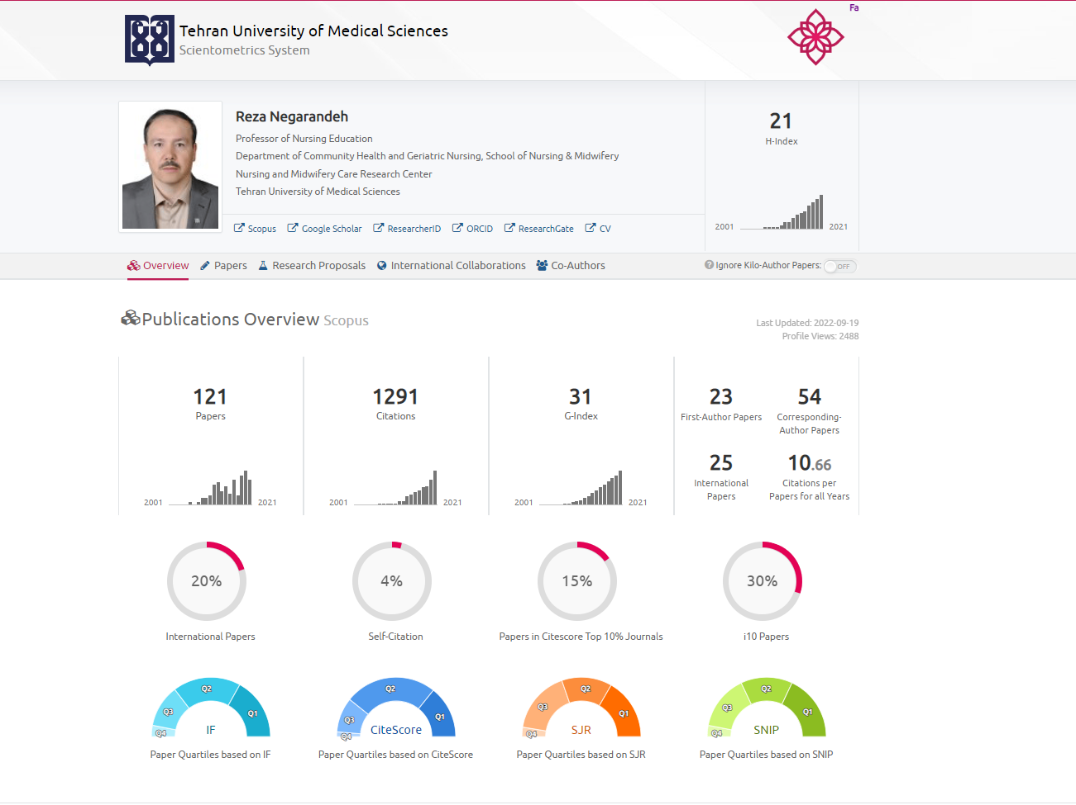

Slide 48
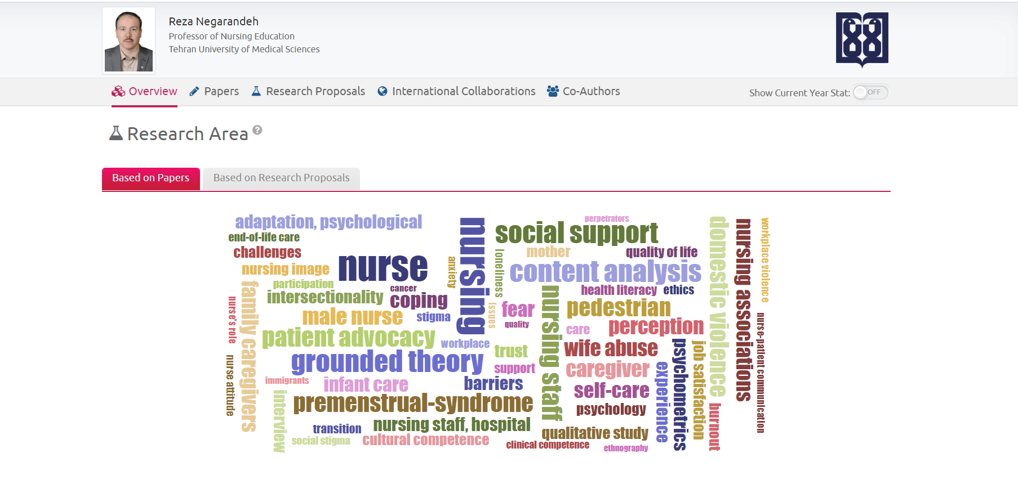

Slide 49
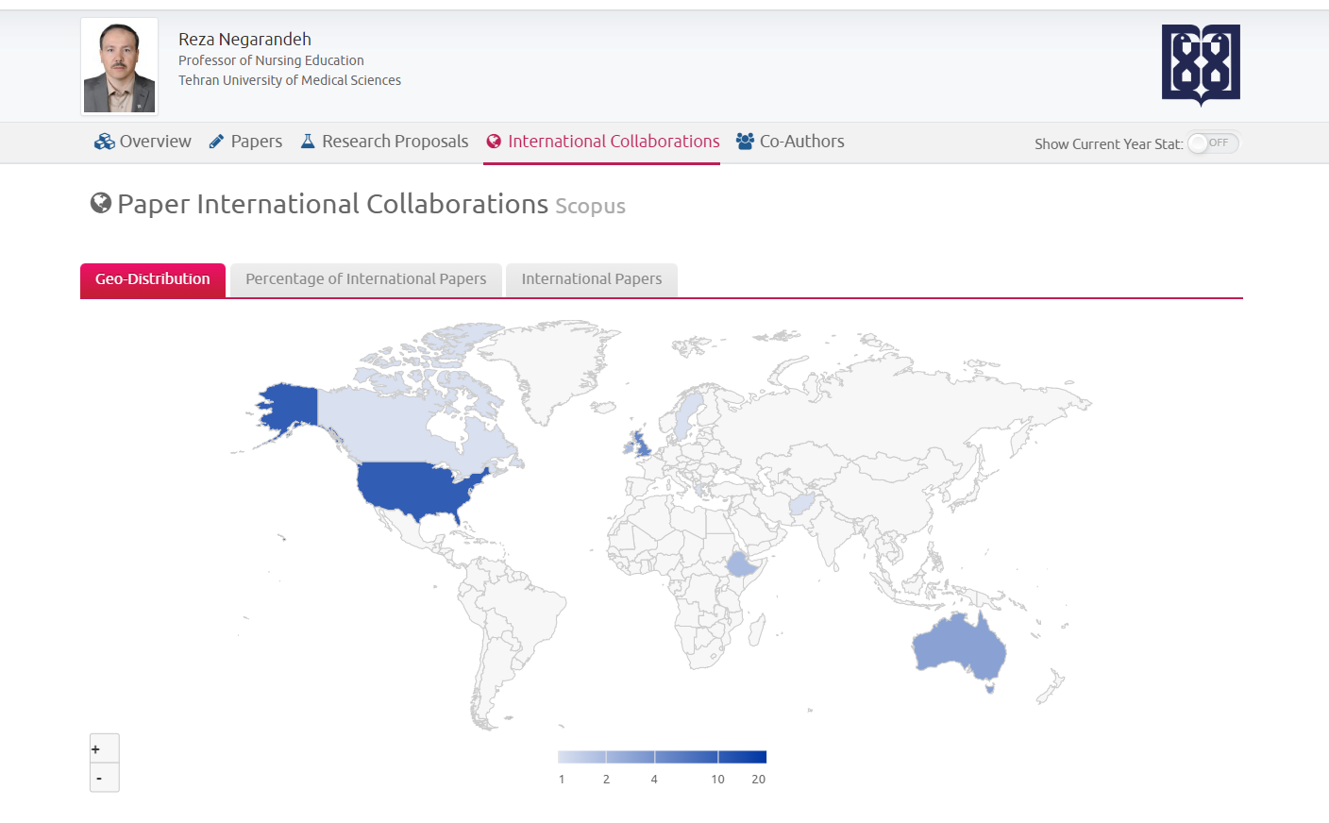
Notes:
https://isid.research.ac.ir/Reza_Negarandeh#paper_international_map-0

Slide 50
Conclusion
The ultimate goal of international nursing research partnerships is to contribute mutual beneﬁts with a sustainable and long-lasting outcome for the patients, community, or country. This happened with the following steps:
The Globalization of Scientific Knowledge
The Global Expansion of Nursing Scholarship
‘Implementation Science’
Prioritizing Globally Relevant Nursing Research
Notes:
how we develop and implement international research?

Slide 51
The Globalization of Scientific Knowledge
New research discoveries occur on an almost daily basis, enhancing not only our world of scientific knowledge, but our local understanding of clinical solutions to solve the important health issues with in our communities.
With each new discovery, we witness how the globalization of nursing science unites and enhances our awareness of the similarities and challenges of health issues.
So, we must continue to expand our knowledge through scientific research.
Notes:
Developing an International Community of Research
PatriciaA.Grady,PhD

Slide 52
Global Expansion of Nursing Scholarship
An important issue to consider in creating international communities of research is that global communication and scholarship represent the ‘‘… extension of collaboration across cultures and countries’’ on a world-wide-scale.

Slide 53
implementation science’
Madon et al. stress ‘implementation science’ that creates generalizable knowledge that can be applied across settings and contexts and addresses those questions that will translate research into local communities of practice.

Slide 54
Prioritizing Globally Relevant Nursing Research
Finally, by working together we can prioritize our science to focus on globally relevant research. The global research community faces an imbalance between research investment and disease burden. This described as ‘Gap’ in the 2000 Global Forum for Health Research. This gap emphasizes that less than 10% of worldwide research is devoted to diseases that account for 90% of the global burden of disease.
Nursing science must lead by addressing those ‘gap’ issues that will initiate and find solutions to relevant health problems.
Notes:
Our vision of evidence-based translational research must thus have global applications to the world nursing community and, through innovative collaborative partnerships, address the real health care issues facing the world’s populations.

